Slide 1

VIDEO TRANSCRIPT SUMMARIZATION USING NLP

Slide 2
Under the esteemed guidance of
Mr.G. Siva Rama Sastry MTech(phD)
Project Guide,
Asst.Professor,
Computer Science and Engineering
RGUKT SKLM

Slide 3
TEAM MEMBERS:
S190441- Choppa Lohitha
S190774- Koribilli Sownya
S190864- Dasari Bhuvaneshwari
S190784- Vennapu Naga surya Durga Prasad

Slide 4
TABLE OF CONTENTS
ABSTRACT
PROBLEM STATEMENT
INTRODUCTION
EXISTED SYSTEM
PROPOSED SYSTEM
EXPERIMENTAL SETUP
CONCLUSION
REFERENCES

Slide 5
ABSTRACT
In the era of high-speed internet, videos have emerged as a predominant medium for disseminating information across various domains, from education to entertainment. The abundance and diversity of online videos present a challenge in efficiently accessing relevant content, often leading to time-consuming searches and distractions from intended tasks. To address this issue, this paper proposes an automated approach to video summarization using speech recognition and natural language processing (NLP) techniques.

Slide 6
PROBLEM STATEMENT:
Massive Influx of content creates challenges for users in finding relevant Information Efficiently.
So there is a need for an Efficient method to Extract Relevant Information from these videos enabling users to quickly grasp the essential content without watching entire videos.
The Aim of this project is to develop a video transcript summarizer using Natural Language Processing(NLP)Techniques The summarizer will process the transcripts of youtube videos and generate concise summaries ,aiding users in understanding the core information rapidly.

Slide 7
INTRODUCTION
Everyday,countless videos are being created and shared on YouTube. and Such videos are the primary source of learning for college and school going students, people preparing for competitive exams and many more people use YouTube for productive outcomes.
MOTIVATION FOR THE WORK:
To provide quick and concise summaries of youtube videos/local videos for users who prefer reading over watching videos based on their native Language

Slide 8
REAL WORLD APPLICATIONS:
Education:Quick summaries for educational content
Content Creation:Summarize content for easier understanding and Sharing.
Accessibility: Making video content accessible to non-English speakers.

Slide 9
EXISTED SYSTEM
Time-Consuming:
Manual transcription of videos is a lengthy process, requiring significant time and effort.
Language Barriers:
Transcripts and summaries may be available only in one or a few languages, limiting accessibility for non-native speakers.
Paid Services for Summaries:
Many existing solutions offer limited free summaries, with advanced features such as longer summaries or enhanced accuracy requiring payment.

Slide 10
PROPOSED SYSTEM
Accurate Summaries:
Utilizes advanced speech recognition and NLP techniques to generate concise and meaningful summaries, ensuring precise content extraction.
Local Videos Without CC:
Processes local videos even without closed captions, providing greater flexibility and usability.
Customized Output:
Allows users to customize the length and content of summaries to meet their specific needs and preferences.

Slide 11
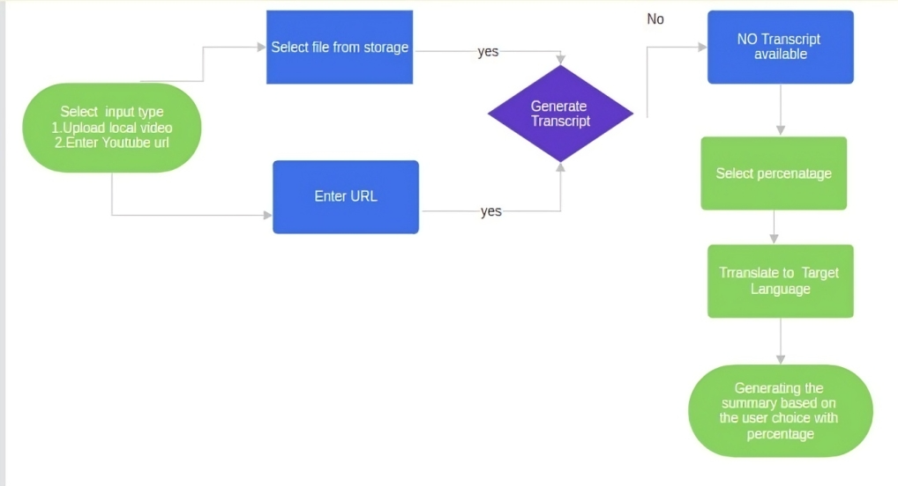
flowchart

Slide 12
ALGORITHM:
1.Import modules
2.Configure API Keys
3.select input type Local video/Youtube URL with subtitles.
4.Generate Transcript
5.Adjust summary length
6.Translate summary to target language if needed
7.Display summary

Slide 13
EXPERIMENTAL SETUP
Technologies used:
1.streamlit
2.Google speech recognition
3.Moviepy
4.YouTube Transcript Api
5.googletrans
6.Bart

Slide 14
DATASETS:
1.Any local video
2.Youtube videos with publicly available transcripts.
SYSTEM HARDWARE
Standard development environment with internet access

Slide 15
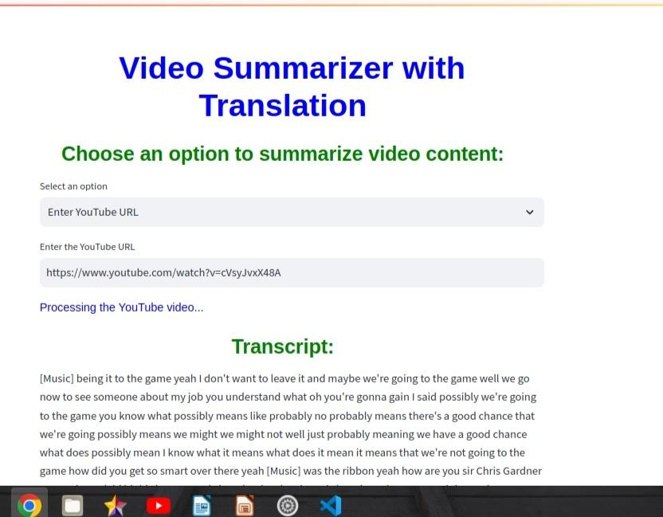
RESULTS:

Slide 16
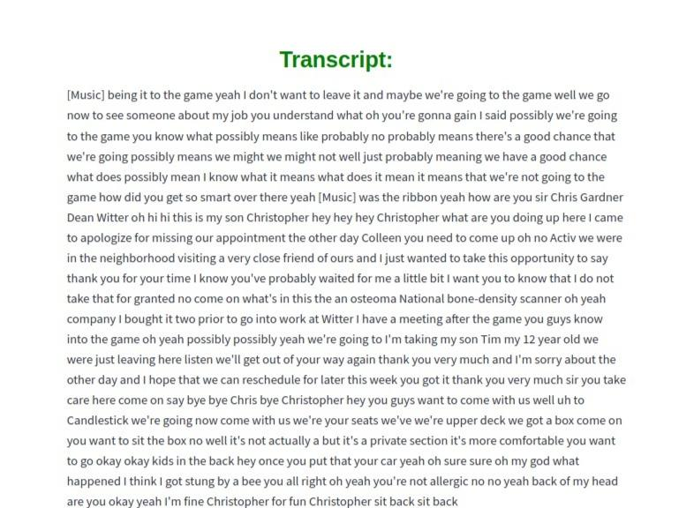

Slide 17
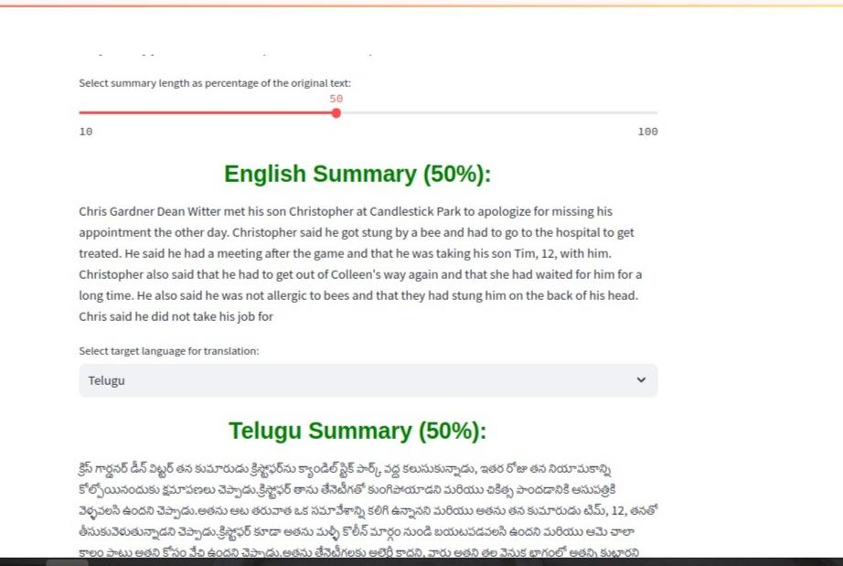

Slide 18
CONCLUSION
The Streamlit app successfully summarizes Local videos and Youtube Videos with subtitles and provides translations in multiple languages.
It addresses the identified research gaps by integrating summarization and translation in a user-friendly platform

Slide 19
FUTURE SCOPE/DIRECTIONS
1)Expand the language support to include more languages.
2)Add features for summarizing videos from other platforms.
3)Integrate more advanced NLP models for better summarization quality.

Slide 20
FUTURE SCOPE
4)Enhance Support for Non-English Videos.
5)Summarize Videos Without Transcripts for any language.
6)Implement User Feedback Mechanisms.

Slide 21
REFERENCES:
1.Video Based Transcript Summarizer for Online Courses using Natural Language Processing | IEEE Conference Publication | IEEE Xplore
2.Automated Youtube Video Transcription To Summarized Text Using Natural Language Processing | IEEE Conference Publication | IEEE Xplore

Slide 22
THANK YOU

